Slide 1
CE 4200 Professional Engineering Practice Issues
Spring 2022 Semester
William D. Lawson, P.E., Ph.D.

Slide 2
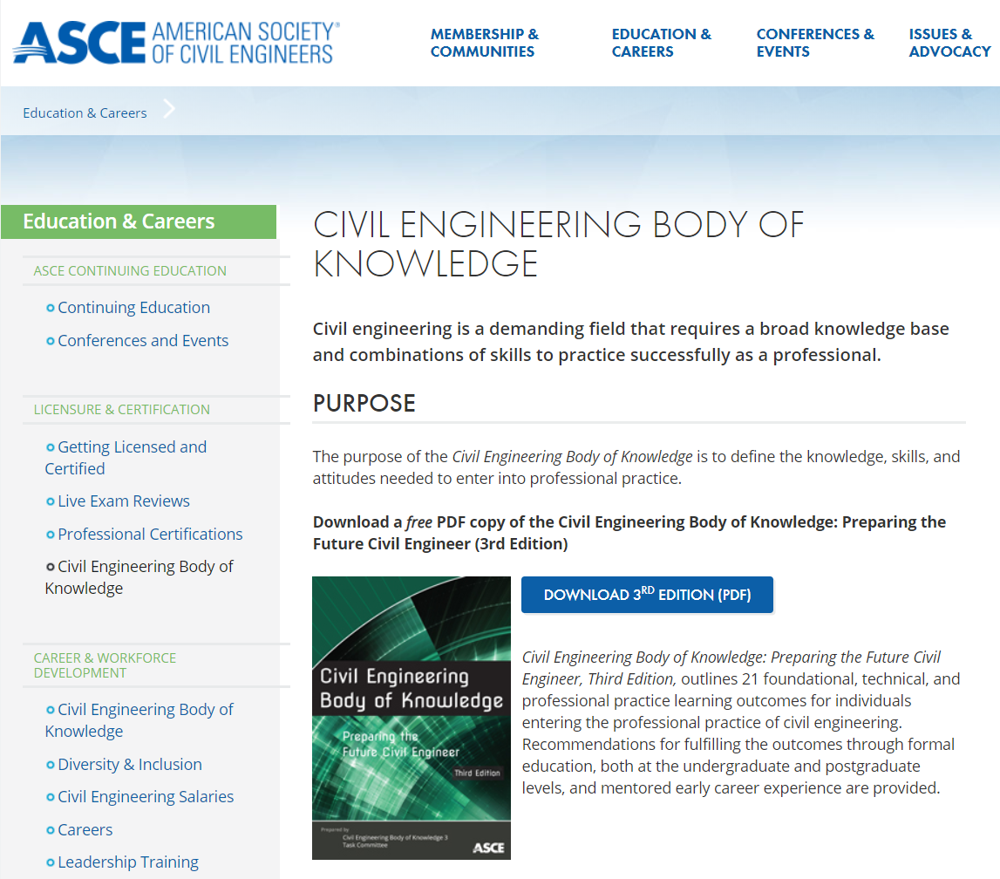

Slide 3

This required course addresses civil engineering body of knowledge topics including preparation for the NCEES Fundamentals of Engineering (FE) Exam, the importance of licensure, leadership and management, public policy, business aspects of engineering, and others. This course integrates technical, professional and social issues to help prepare senior BSCE students to enter professional practice.

Slide 4
ASCE Body of knowledge (CEBOK3 & CEBOK2)
CE 4200 Professional Engineering Practice Issues

Slide 5

Exercise 1.1 What does it take to be a SUCCESSFUL Civil Engineer?
Think about and jot down at least 3 skills – other than technical competency – you think are necessary to successfully practice civil engineering (individual assignment).
Be prepared to discuss your ideas.

Slide 6
Civil Engineering Body of Knowledge: Preparing the Future Civil Engineer

Slide 7
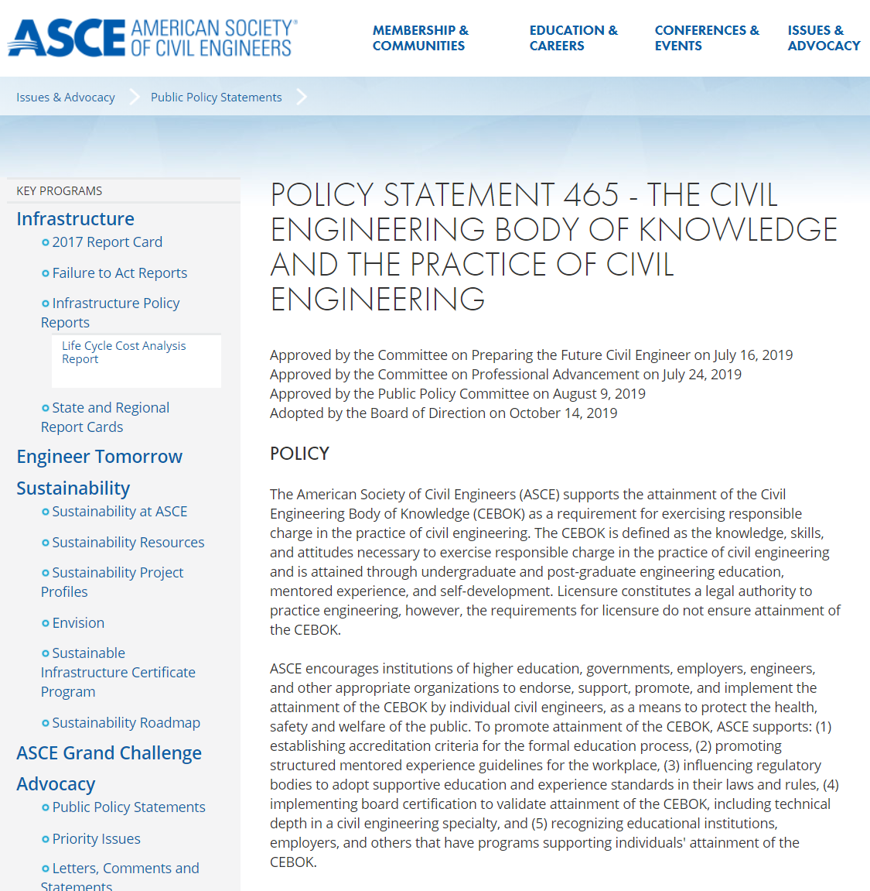
ASCE Policy Statement 465

Slide 8
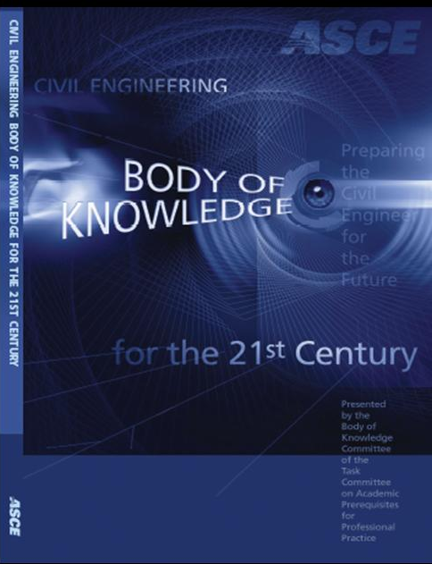
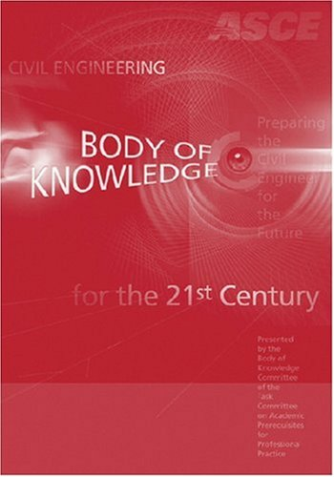
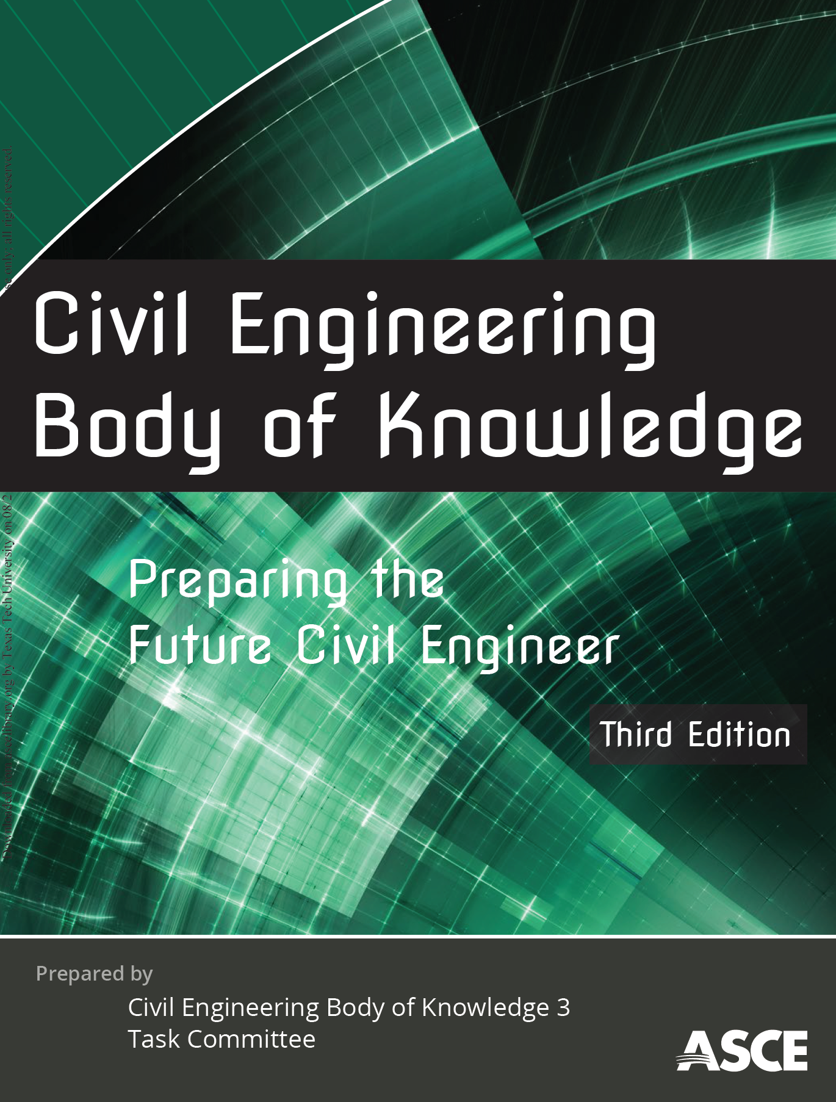
CEBOK1 (2004)
CEBOK2 (2008)
CEBOK3 (2019)

Slide 9
Outcomes Civil Engineering Body of Knowledge for the 21st Century
Outcomes are statements that describe what individuals are expected to know and be able to do by the time of entry into the practice of civil engineering at the professional level in the 21st century—that is, attain licensure.
Outcomes define the knowledge, skills, and attitudes that individuals acquire through appropriate formal education and pre-licensure experience.

Slide 10
CEBOK3
Published Mar 2019
Compliant with 2016-17 and later ABET Program Objectives
21 Learning Outcomes
Cognitive and Affective levels of achievement

Slide 11
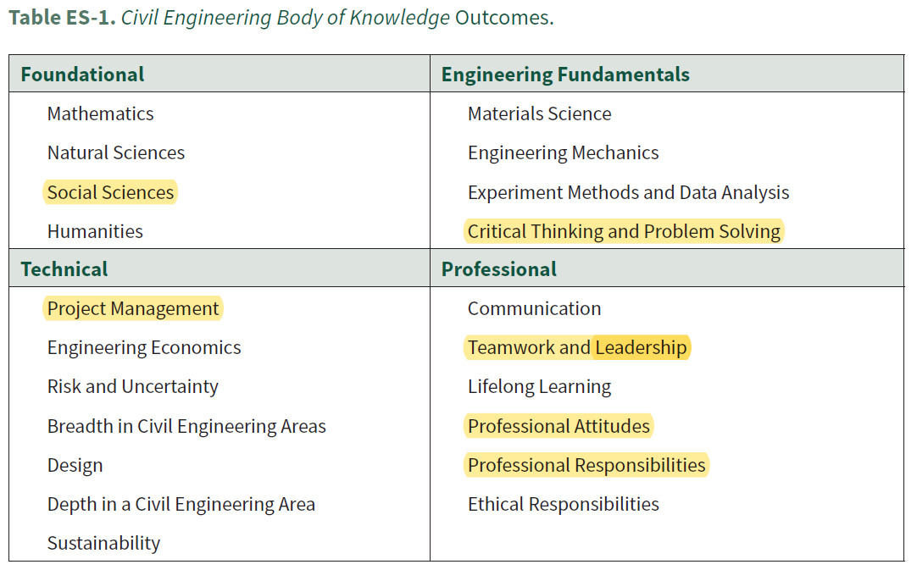
CEBOK3 Outcomes Civil Engineering Body of Knowledge for the 21st Century

Slide 12

Example 1.2 CEBOK3 Professional Responsibilities
Domain (cognitive or affective)
Level of achievement (SIX levels, Bloom’s taxonomy)
Demonstrated ability (note the verb)
Typical pathway (expert status, for licensure, for undergraduate study)

Slide 13
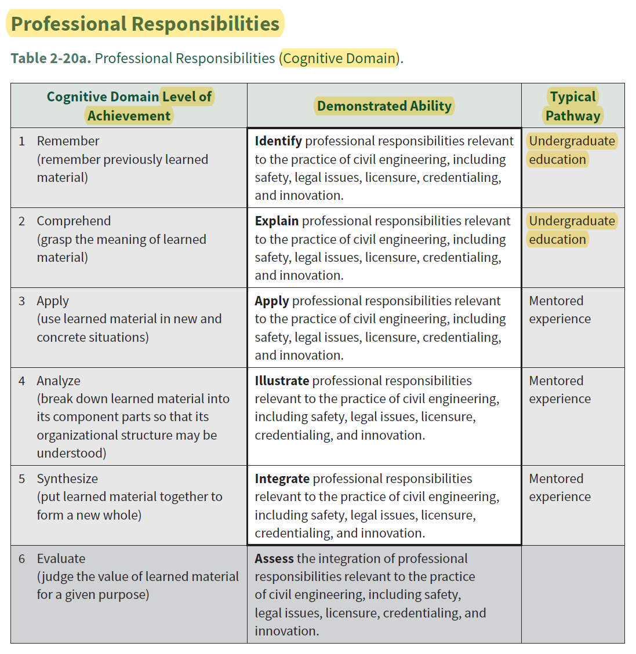

Slide 14
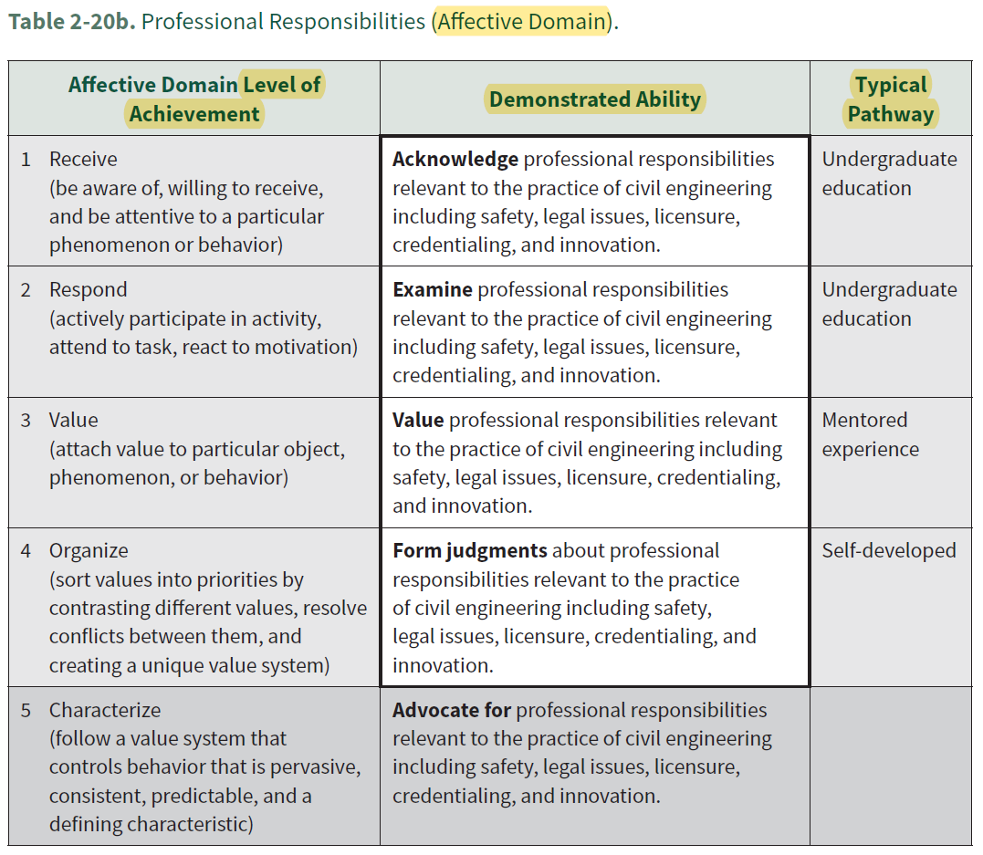

Slide 15

Where This Course Fits In
http://www.iheartorganizing.com

Slide 16
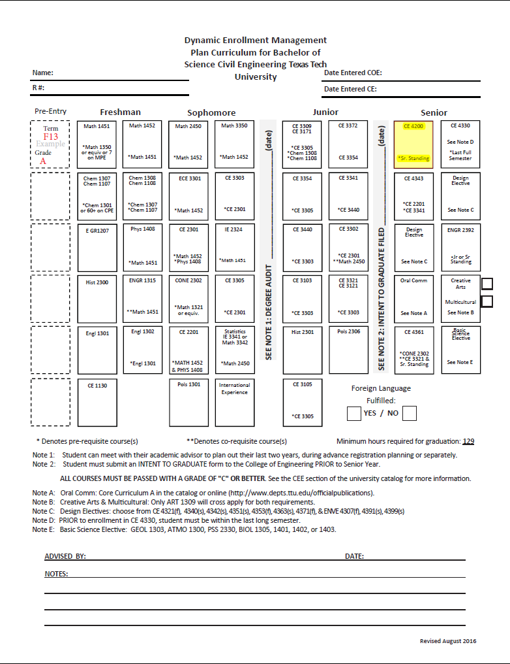
Civil Engineering Curriculum

Slide 17
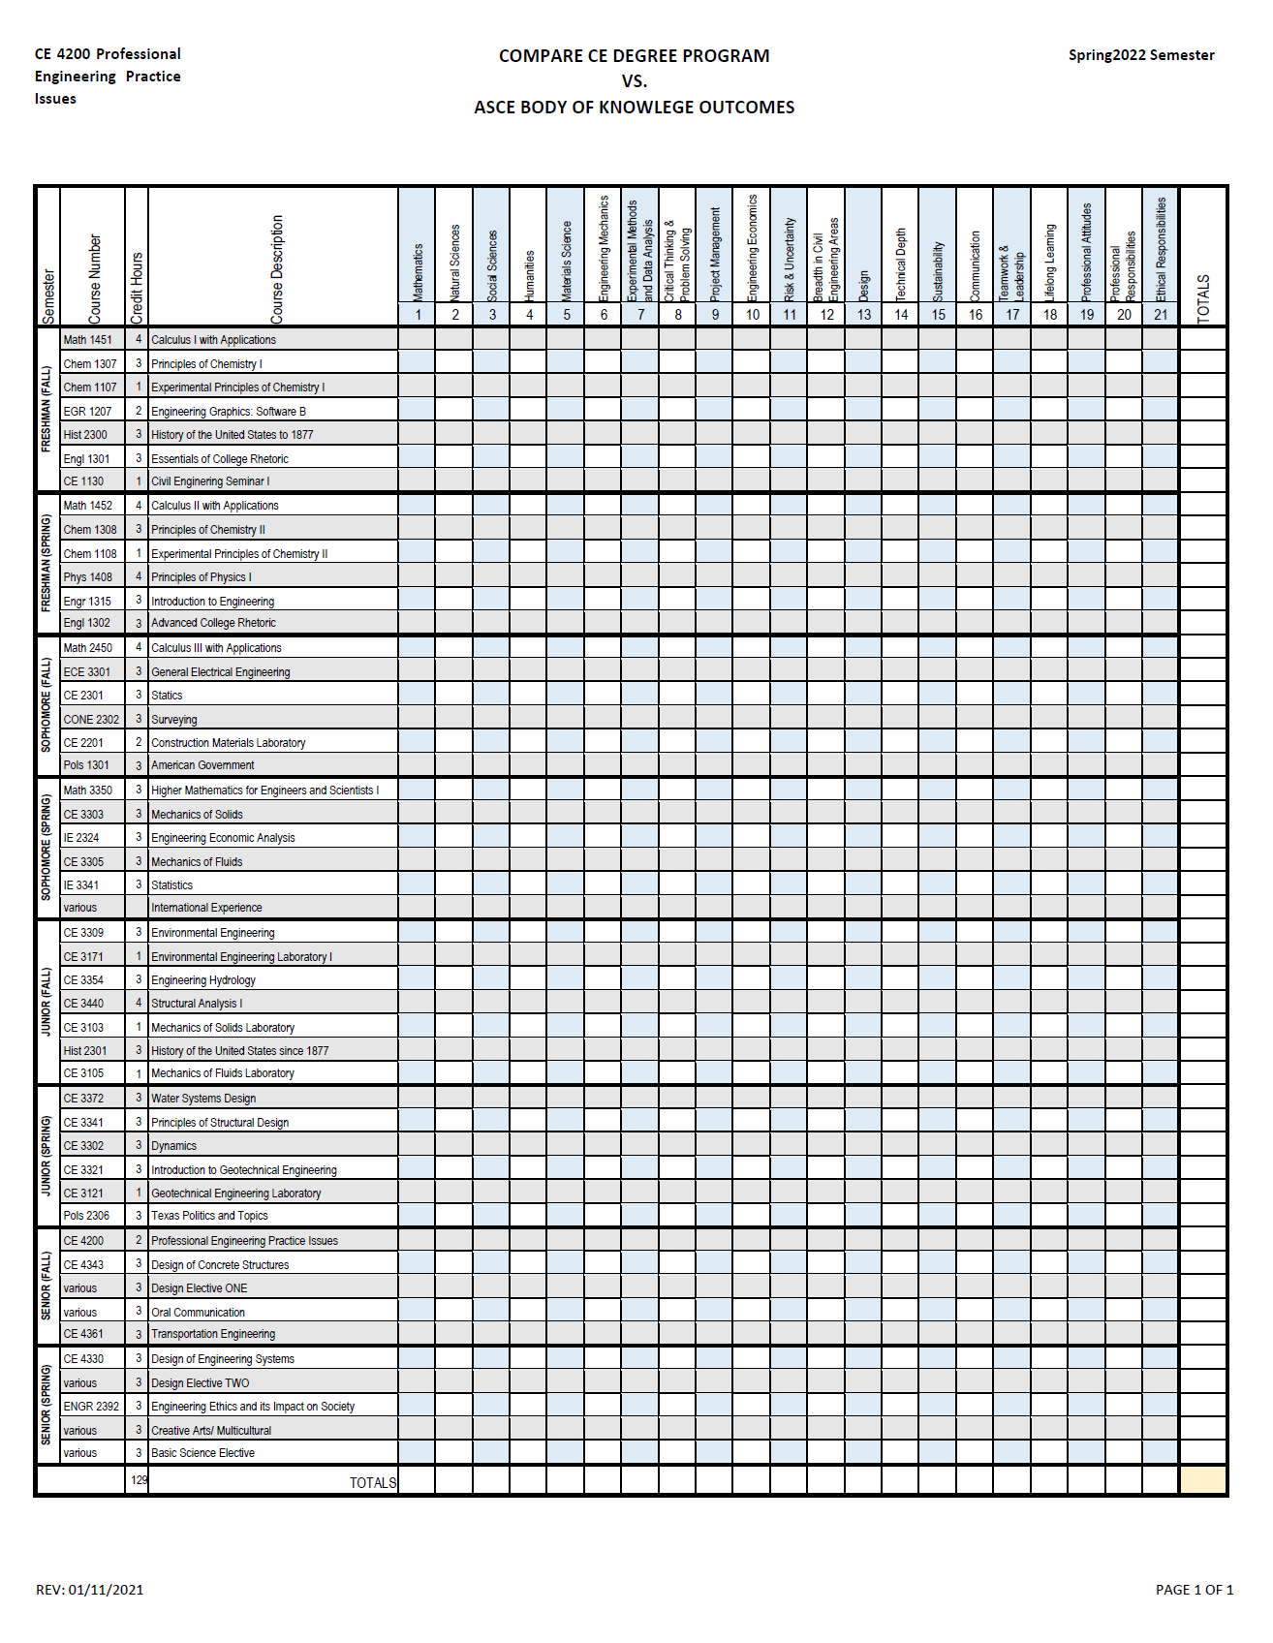
Assignment 1: Compare DEMP vs. BOK3E

Slide 18
ABOUT THE COURSE
CE 4200 Professional Engineering Practice Issues

Slide 19


F2F & Distance Course Format
SYNCHRONOUS
ASYNCHRONOUS

Slide 20
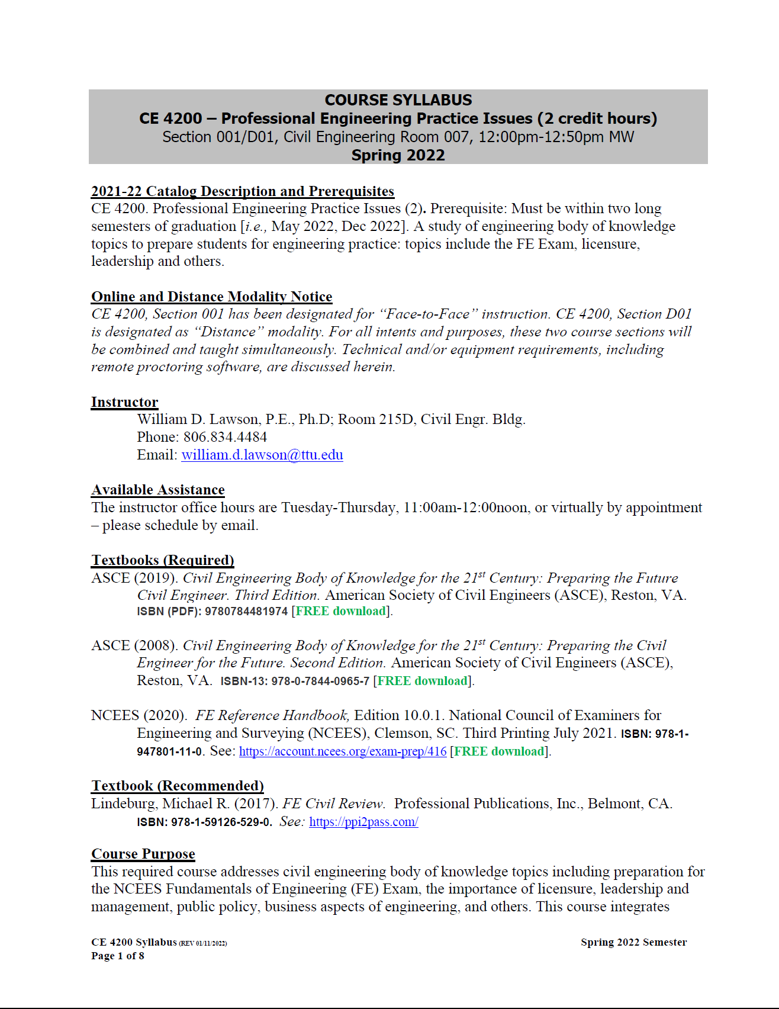

Slide 21
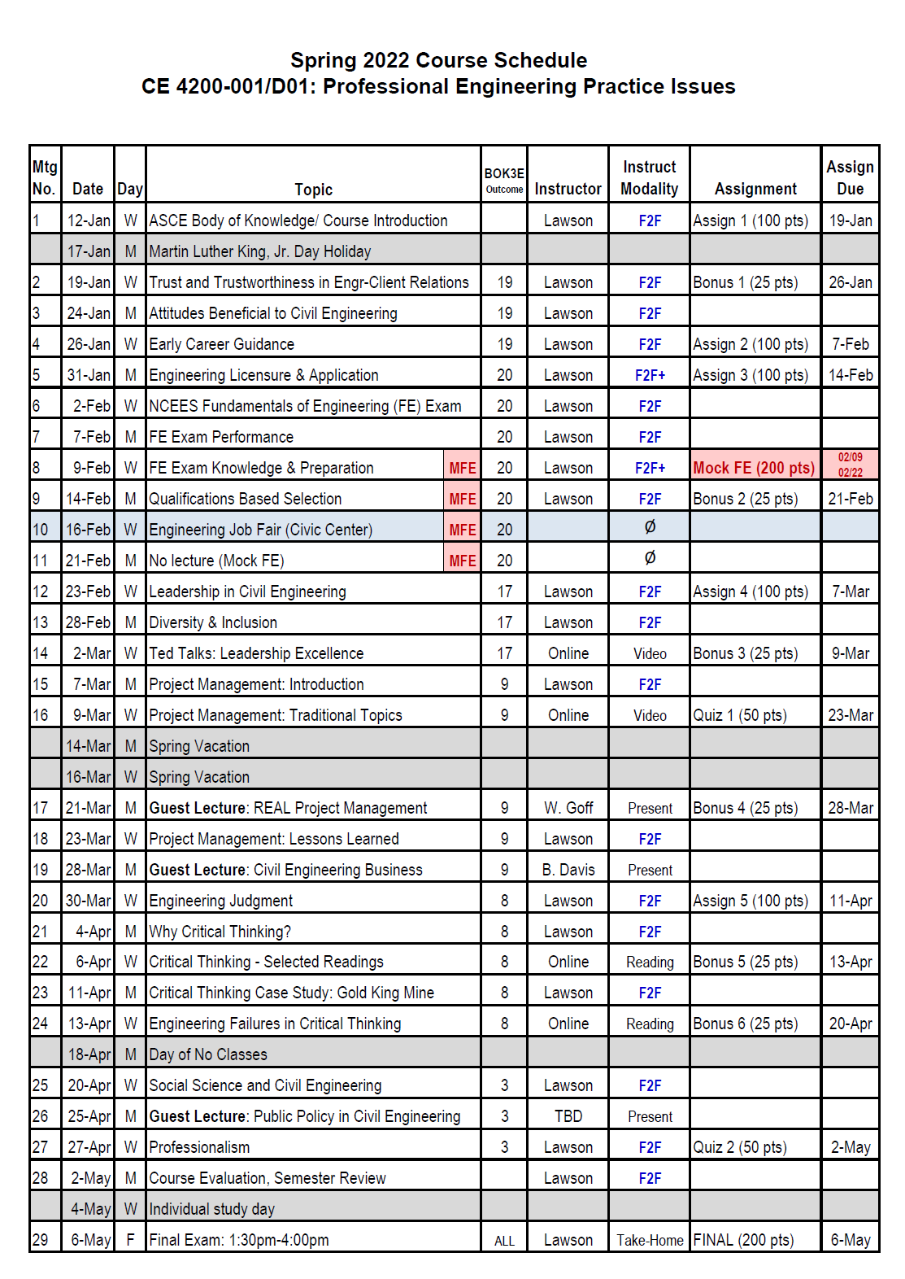

Slide 22
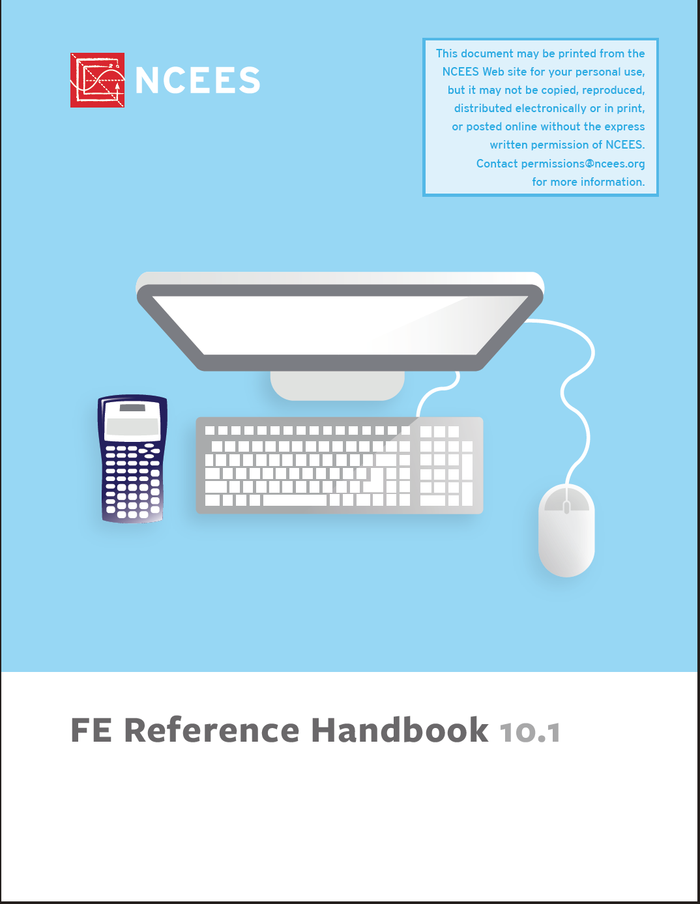

Textbooks
1 2 3
free free? $$$

Slide 23
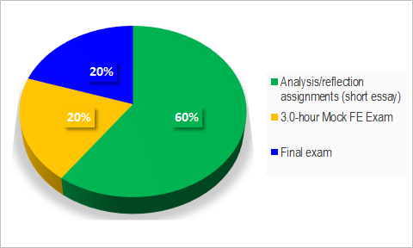
Evaluation Process

Slide 24
ANALYSIS/ REFLECTION ASSIGMENTS
ASCE BODY OF KNOWLEDGE
EARLY CAREER GUIDANCE
ENGINEERING LICENSURE
LEADERSHIP IN CIVIL ENGINEERING
PROJECT MANAGEMENT (Quiz)
ENGINEERING JUDGMENT
PROFESSIONALISM (Quiz)
+
MULTIPLE BONUS OPPORTUNITIES

Slide 25
MOCK FE EXAM
The Mock Fundamentals of Engineering (FE) Exam is an approximately half-length version of the real NCEES FE Exam for Civil Engineering students. More specifically, the Mock FE is a diagnostic test where students complete 62 FE-type questions over 14 topics of civil engineering knowledge in 3 hrs.

Slide 26
FINAL EXAM
Based on your review of the Texas Engineering Practice Act and Board Rules
You will be asked to consider a series of real-world professional conduct and ethics scenarios
Following each scenario, you will be asked one or more questions where you will choose the best answer for each of the questions

Slide 27
ANY QUESTIONS?
CE 4200 Professional Engineering Practice Issues

